Slide 1


SOCIAL BUZZ ANALYSIS PROJECT
Presented by: Millicent Patrick
Date: 25/5/24

Slide 2


Analysis of Top Performing Content Categories
A comprehensive analysis of content reactions and category performance of Social Buzz
Content:
1.Project Recap
2.Problem Statement
3.The Analytics Team
4.Process and Methodology
5.Insights
6.Summary

Slide 3

Social Buzz is a fast growing technology unicorn that needs to adapt quickly to its global scale.
Accenture has begun a 3 month POC focusing on these tasks.
1.An Audit of Social Buzz’s Big data practice
2.Recommendations for a successful IPO
3.Analysis to find Social Buzz’s Top 5 most popular categories of content
Project Recap

Slide 4

Problem
Over 100,000 posts per day !
36,500,000, pieces of content per year !
But how to capitalize on it when there’s so much ?
Analysis to find Social Buzz’s Top 5 most popular categories of content

Slide 5



The Data Analytics Team
Andrew
Andrew Fleming - Chief Technical Architect
Marcus Rompton - Senior Principal
Millicent Patrick – Data Analyst
Marcus
Millicent

Slide 6
1
Data Understanding
Process
2
Data Cleaning
3
Data Modelling.
4
Data Analysis
5
Insights
.

Slide 7
Insights
 | CATEGORY | TOTAL SCORE |  | CATEGORY | TOTAL SCORE
1 | Animals | 73724 | 10 | education | 58411
2 | science | 71351 | 11 | fitness | 55303
3 | healthy eating | 67710 | 12 | tennis | 54569
4 | food | 67659 | 13 | dogs | 52720
5 | technology | 66180 | 14 | Studying | 50977
6 | travel | 65824 | 15 | public speaking | 50188
7 | culture | 64713 | 16 | veganism | 47900
8 | cooking | 64064
9 | soccer | 62352 |  | Grand Total | 973645

Slide 8

Insights
16
73724
JANUARY
MONDAY
UNIQUE CATEGORIES
REACTIONS TO “ANIMALS” POSTS
MONTH WITH MOST POSTS
DAY OF WEEK WITH MOST POSTS

Slide 12
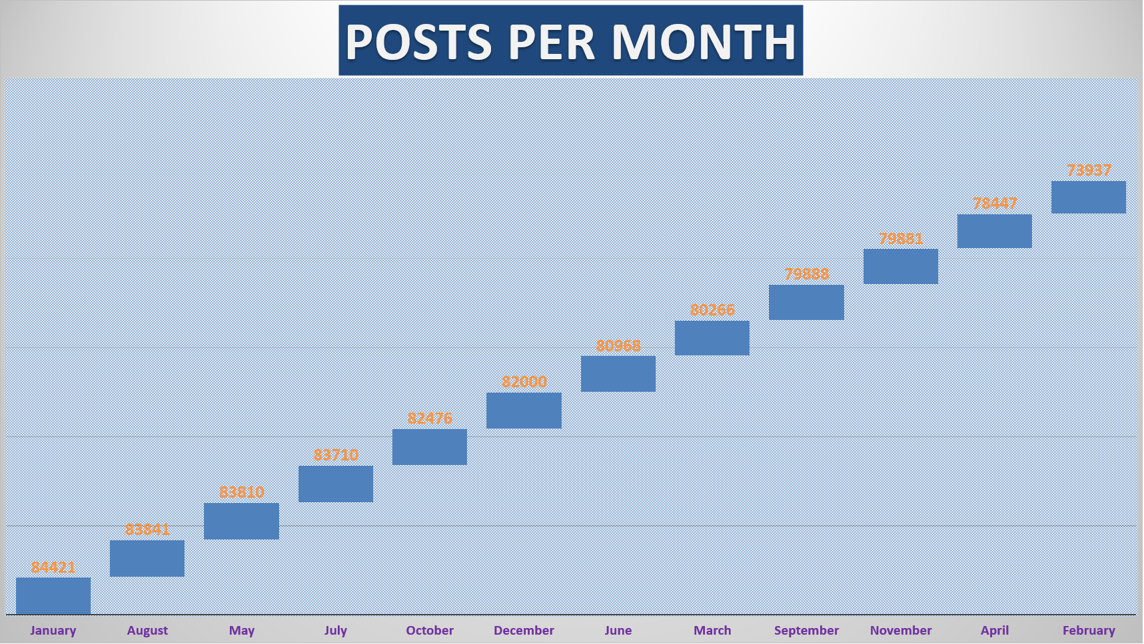

Slide 13

Summary
Analysis
Animals and Science are the 2 most popular categories of content showing that people enjoy, "real life” and “factual” content the most.
Insights
Food is a common theme with the top 5 categories with , “healthy eating” ranking the highest.
This may give an indication to the audience within your user base .
You could use this insight to create a campaign and work with healthy eating brands to boost user engagement.
Next steps
This ad hoc analysis is insightful, but its time to take this analytics into large scale production for real time understanding of your business.
We can show you how to do this.

Slide 14
Thank you!
ANY QUESTIONS?

